Slide 1

GitHub
- track changes on steroids

Slide 2



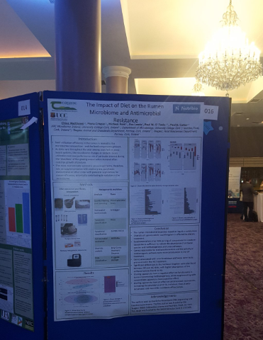

How is research presented?
Theses
Papers
Books
Posters
Talks
Notes:
It’s important to remember that these documents are not the research. Especially in the computational and statistical sciences, these documents are the “advertising”. The research is the “full software environment, code, and data that produced the results”. When we separate the research from its advertisement we are making it difficult for others to verify the findings by reproducing them.

Slide 3
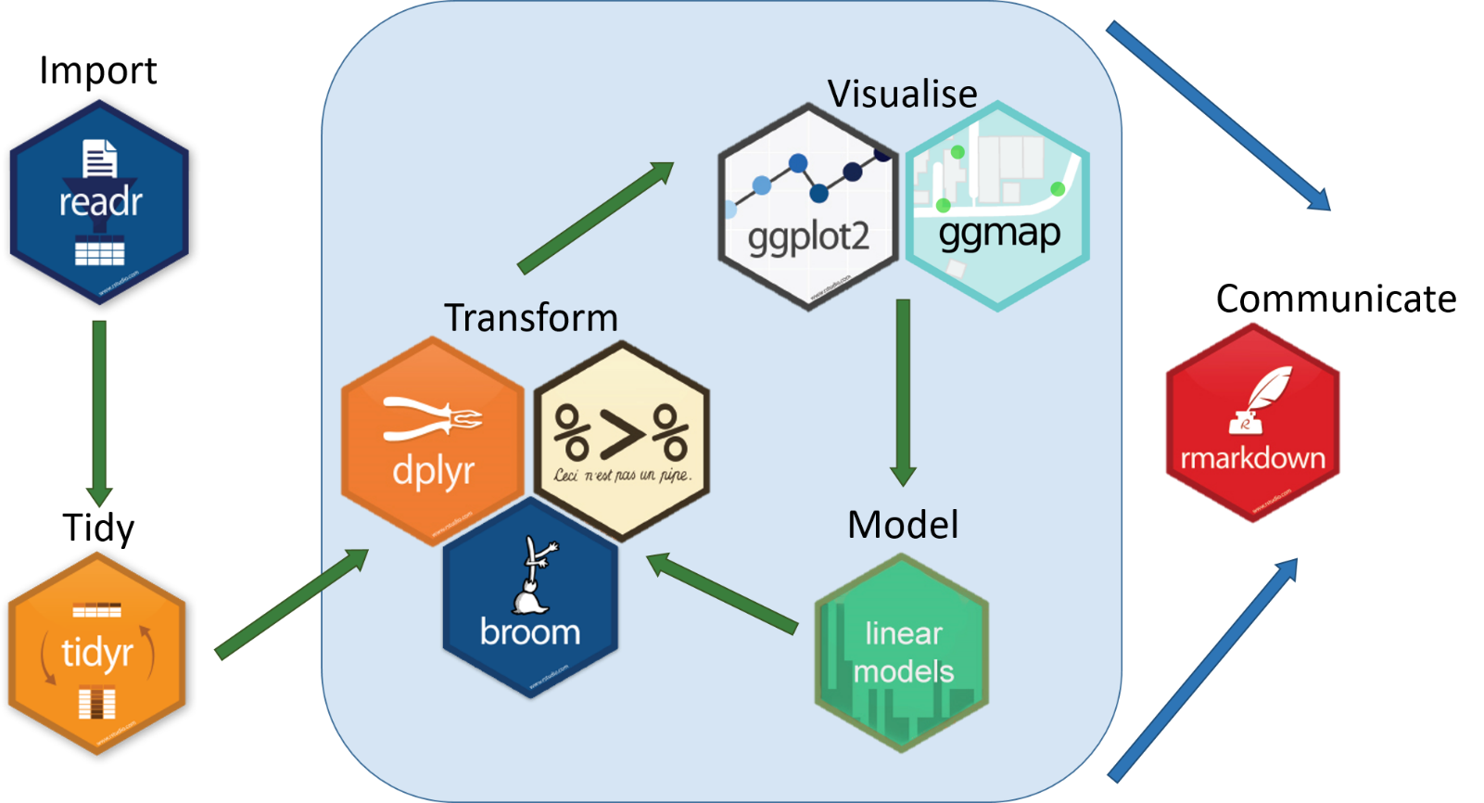

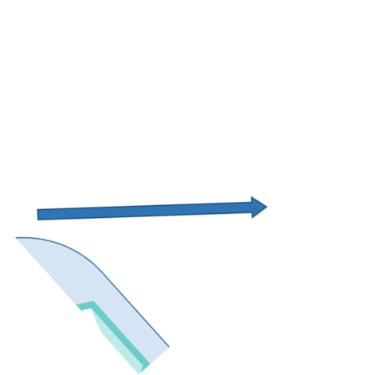
Putting the pieces together

Slide 4
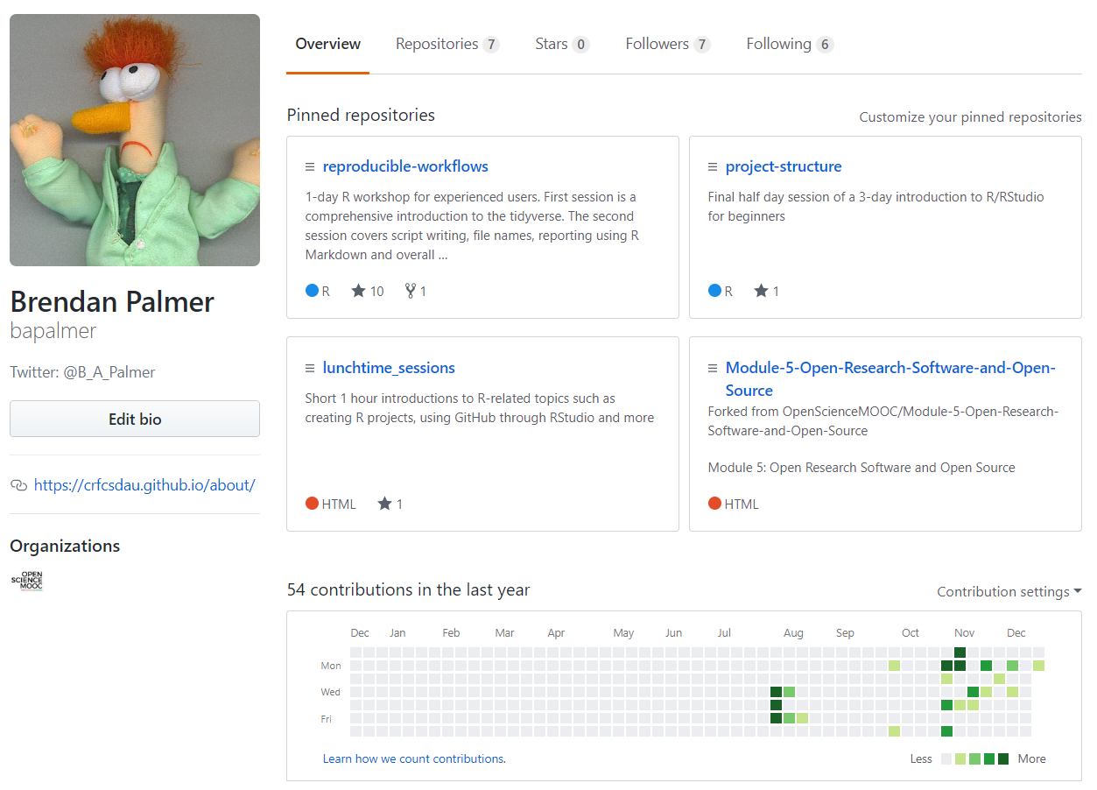
Sounds complicated
It isn’t
To get up and running takes only a few steps
Any idiot could do it….
Notes:
Any idiot could do it. AS the only idiot in this room, allow me to pass on some sage advice and life lessions. As you can see my contributions to Github haven’t been remarkable to date. The initial flurry back in August was through the git directly as I sought to catalogue an original series of introductory R workshops I gave here in UCC.
However, I came across a very useful MOOC that detailed how to link git to RStudio. Now everything is immeasurably easier. As you can see from my recent up-tic in activity!!

Slide 5

What is git, gist, GitHub?
git is a version control system
originally designed to allow developers share code
since repurposed to manage whole data projects
gists are individual files or part of files that can be shared
GitHub is a hosting service for your Git projects
remotely stored
Notes:
Is git useful for single users? Probably not! But the benefits come when you work with collaborators or want to share your code with others
The pros of Git only outweigh the cons when you factor in the overhead of communicating and collaborating with other people, so if you’ve got code spread across multiple harddrives, or on dropbox
Great way of avoiding that annoying state where you have multiple copies of the same file. You get to keep copies of all of your work over time.
Who made the contribution, what they did and when.

Slide 6
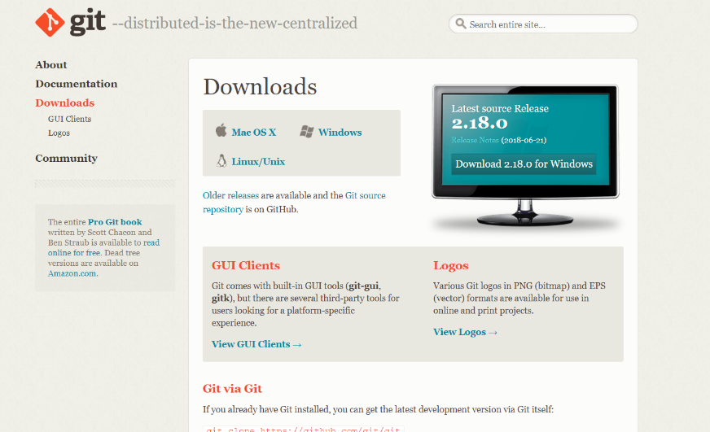
Step 1: Install git
Step 1: Install git after step 0, install R/RStudio

Slide 7

Notes:
Make sure to Select “Use Git from the Windows Command Prompt” during installation.
For now, just choose all the usual default options for each install. Depending on which Operating System (e.g., Mac, Windows, Linux), this might be different for each of you.
For Linux users, simply use the following command to install Git:
sudo apt-get install git-core

Slide 8


Slide 9

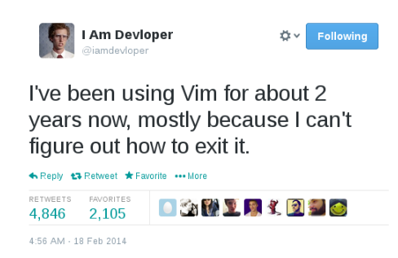

Slide 10


Slide 11
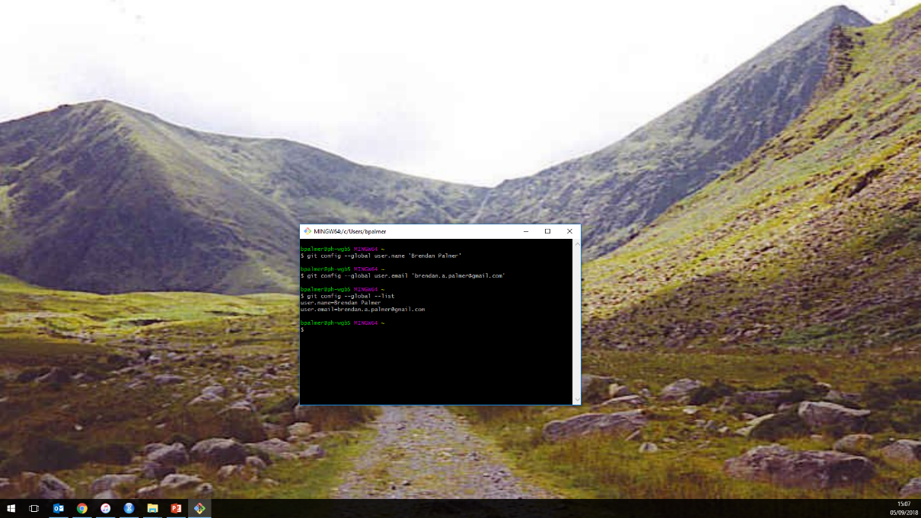
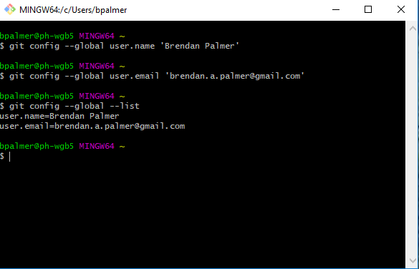
Notes:
This is the place where you can use the command-line to access Git from outside of RStudio.
Maybe now go to the desktop and open git
Don’t worry if you’ve never used the shell before because it’s quite similar to using R, or any other coding system. The main difference here though is that instead of calling functions like in R, you call commands.

Slide 12
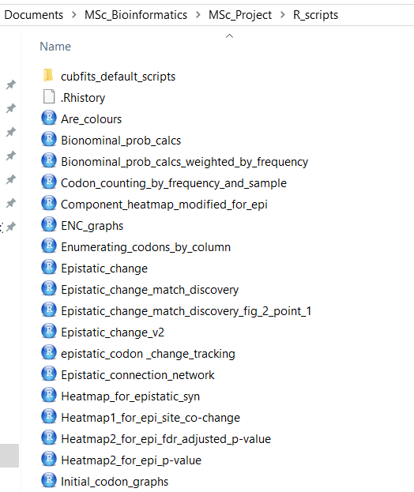
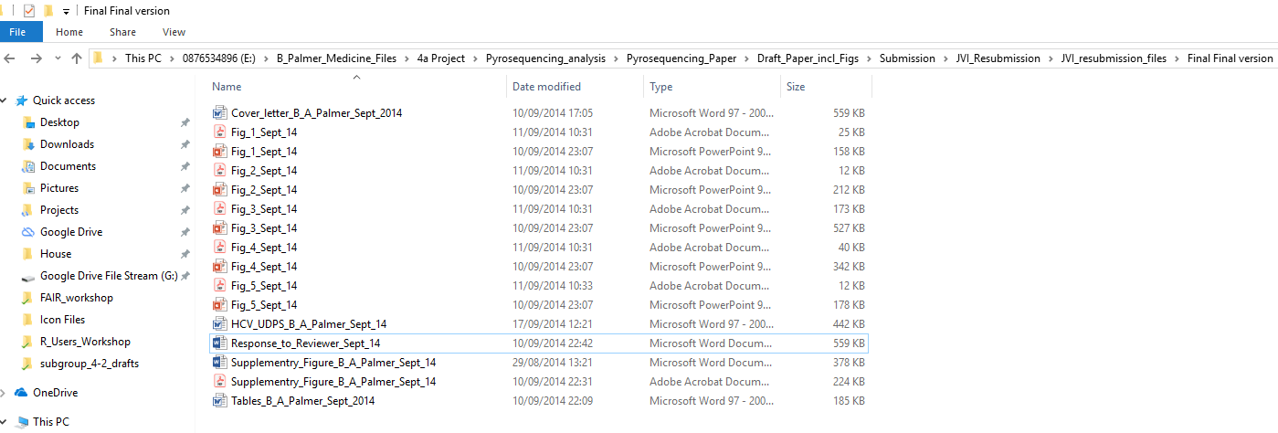
What’s there to gain
A record of your research
Avoid that chaotic state where you have multiple copies of the same file, but without a stupid and annoying file naming convention.
Notes:
enables you to save and track time-stamped copies of your work throughout the process
This is important, as all research goes through changes and sometimes we want to know what those things were.
Did you delete some text that you now think is important? Version control will save that for you.
Did your code work perfectly before, but is now throwing error messages? Version control.

Slide 13
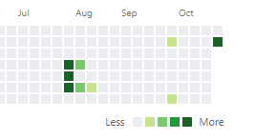
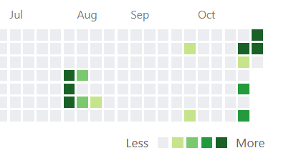
Discovered git
Discovered Open Science MOOC
Got confused!
Notes:
Massive Open Online Community for Open Science

Slide 14
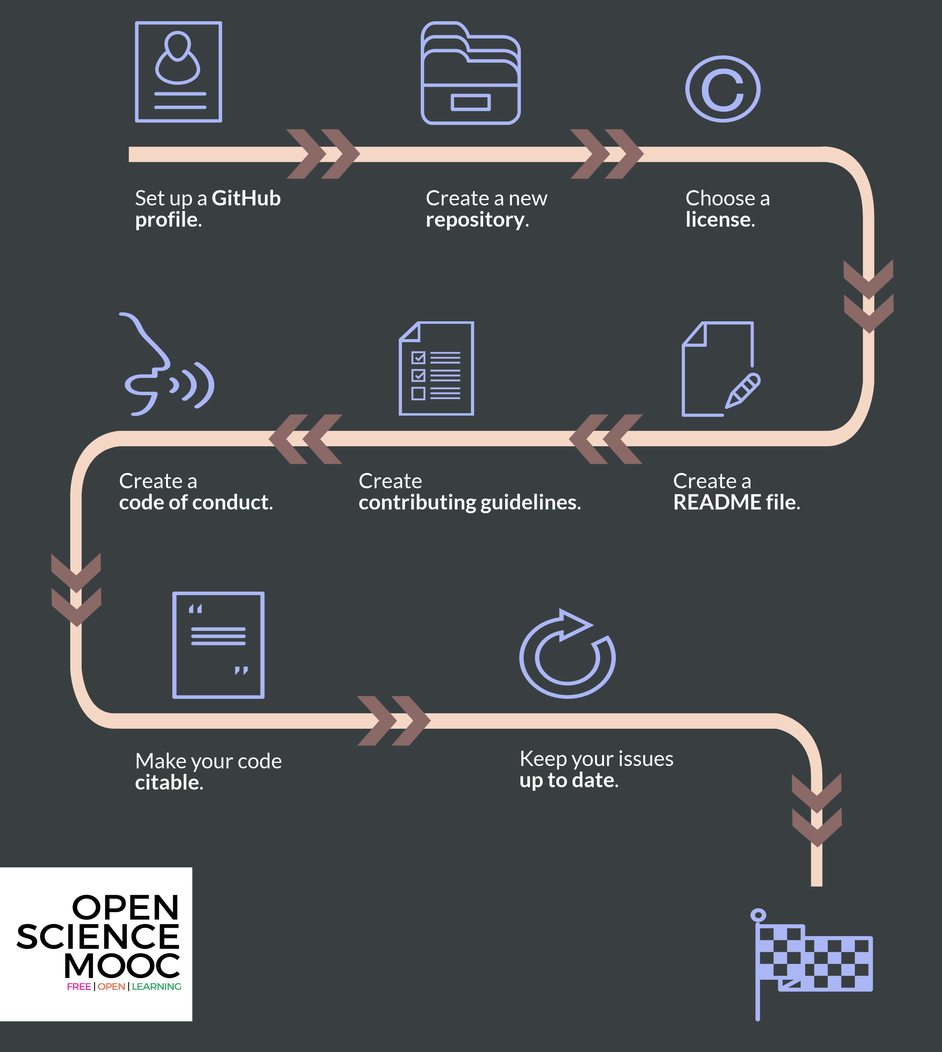

Getting started with GitHub
Notes:
Is git useful for single users? Probably not! But the benefits come when you work with collaborators or want to share your code with others
The pros of Git only outweigh the cons when you factor in the overhead of communicating and collaborating with other people

Slide 15
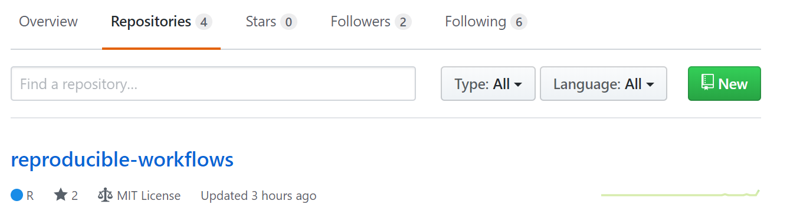
Step 2: Go to GitHub and create a repository
Notes:
A repository is just another name for a project. Here you can manage projects, store files and openly collaborate with others.
Give it a meaningful name, don’t duplicate names, infringe on trademarks etc
Any GitHub repository requires 4 key elements to get started and to begin developing a welcoming community:
An Open Source license;
A README file;
Contributing guidelines; and
A Code of Conduct.
After this week I hope to fill in the gaps on the final two of these

Slide 16
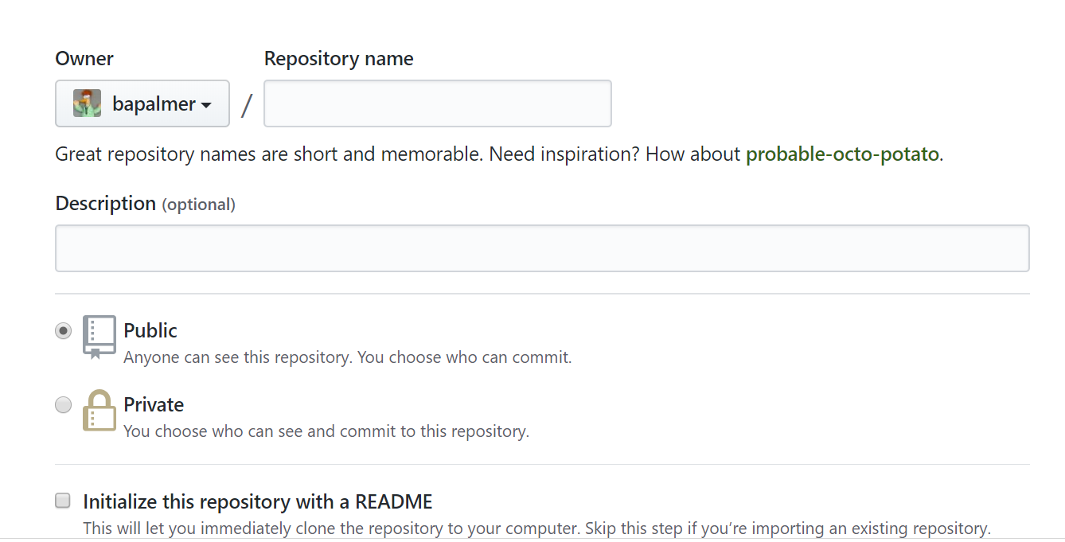
Step 3: Give it a useful name
Notes:
I didn’t know a lot about licences when I first started this but the MIT License is a permissive license that lets people do whatever they want with your code as long as they provide appropriate attribution to you, and do not hold you liable.
Luckily you can select an existing license from a drop down menu. You can create a new license but this is beyond my expertise right now.

Slide 17
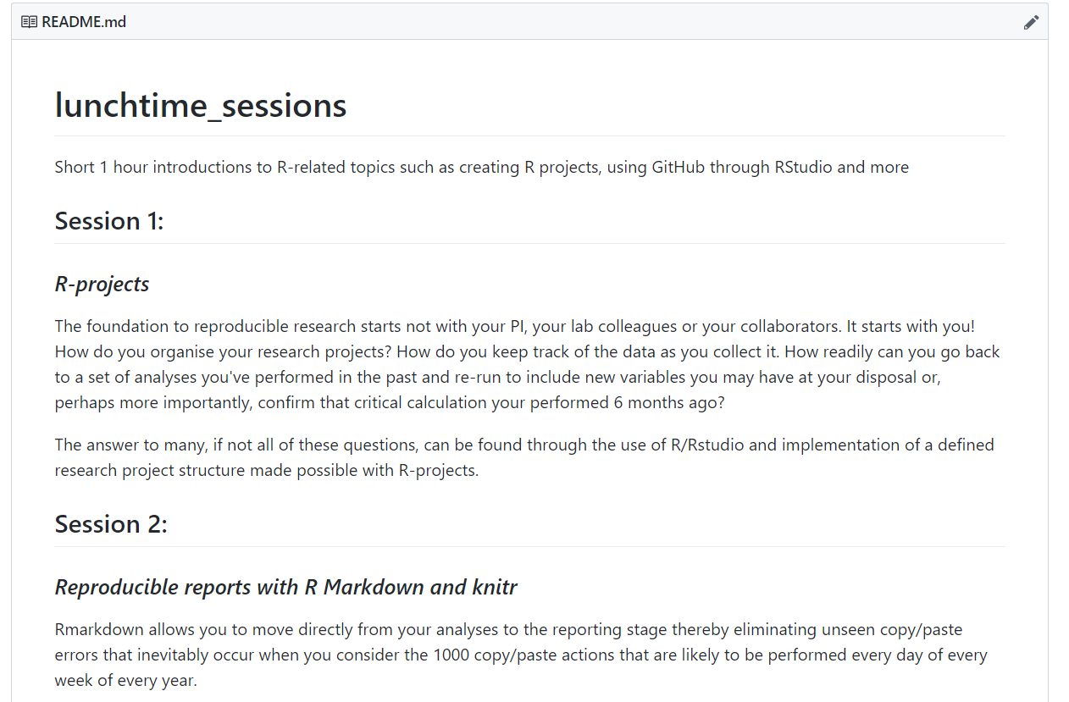
Step 4: Populate the README file
Notes:
When you initialise your new repository, there should be an option to do so with a README file. These do exactly what they say - provide key information about the project. These are typically the first thing outside contributors will see when they come to your repository, so making them informative and welcoming is key.
Include some useful information such as
- What is this project about and what does it do.
- Why should people care, and why is it useful.

Slide 18
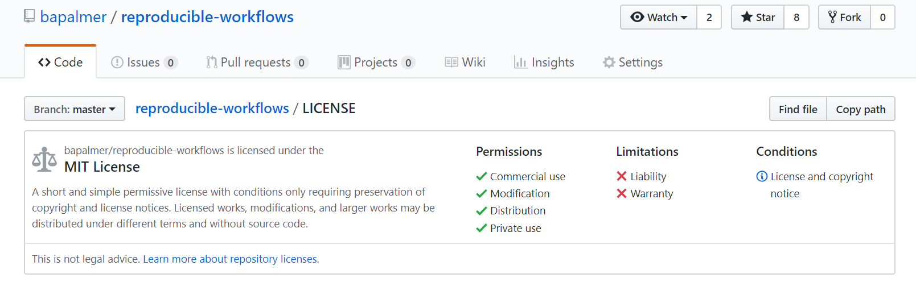
Step 5: Add a licence
Notes:
When you initialise your new repository, there should be an option to do so with a README file. These do exactly what they say - provide key information about the project. These are typically the first thing outside contributors will see when they come to your repository, so making them informative and welcoming is key.
Include some useful information such as
- What is this project about and what does it do.
- Why should people care, and why is it useful.

Slide 19
Step 6: Interface git with RStudio
The key here is to select the correct shell
Windows users have four options
Only one of these is correct
Notes:
When you initialise your new repository, there should be an option to do so with a README file. These do exactly what they say - provide key information about the project. These are typically the first thing outside contributors will see when they come to your repository, so making them informative and welcoming is key.
Include some useful information such as
- What is this project about and what does it do.
- Why should people care, and why is it useful.

Slide 20
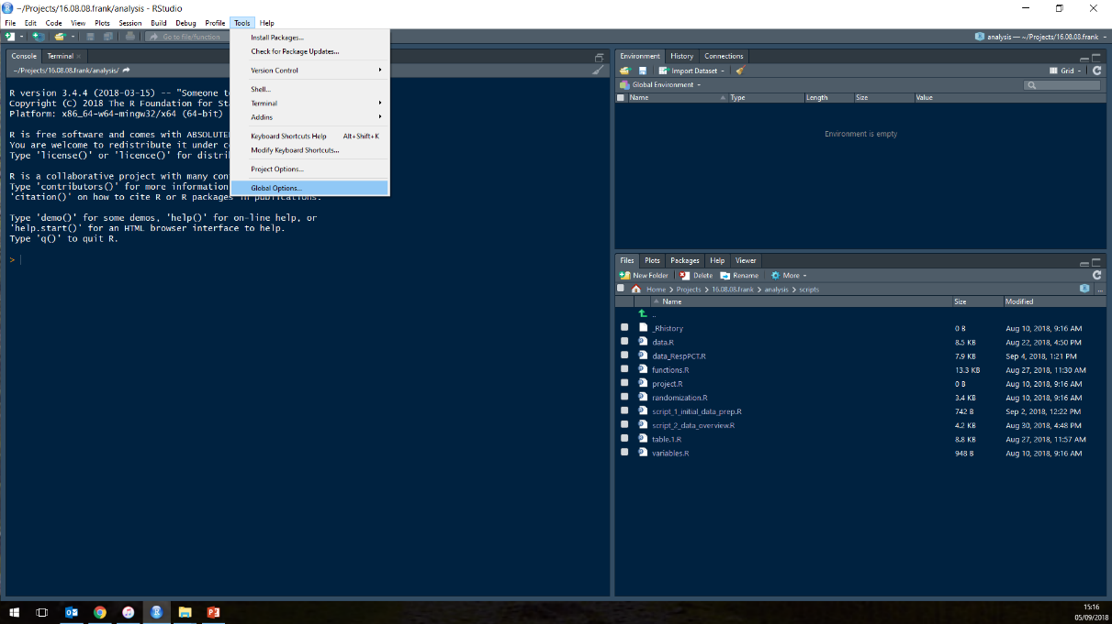
Notes:
Link Rstudio to the shell

Slide 21
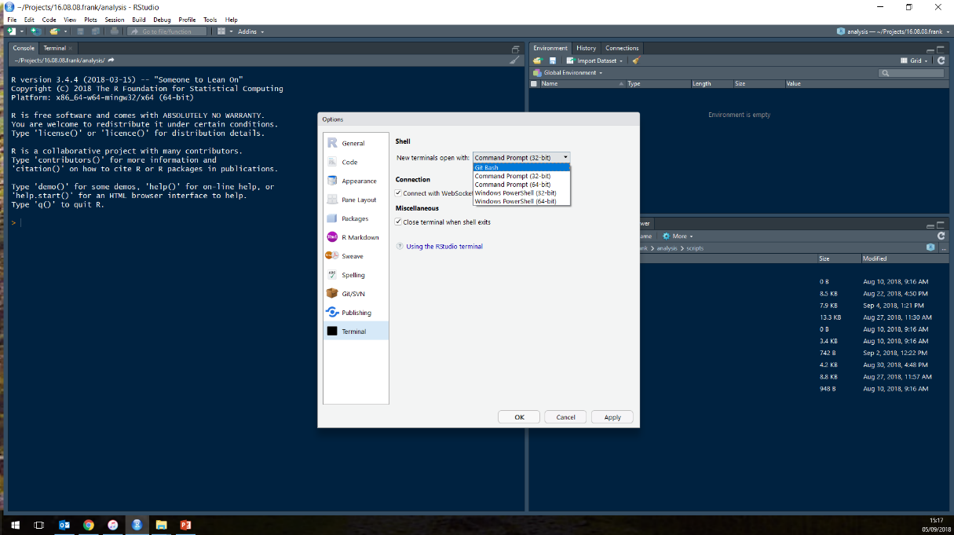

Slide 22
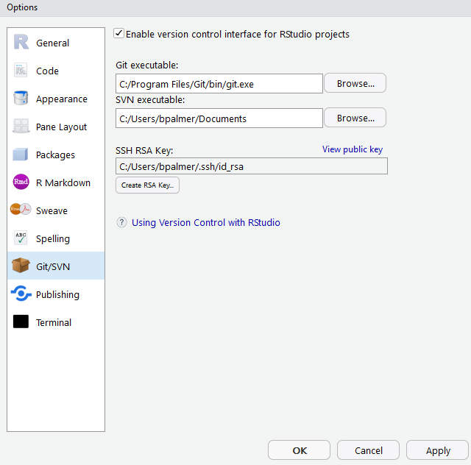
Step 6: Interface git with RStudio
Notes:
Tools > Global Options > Git/SVN (SVN is just another version control software)
In the place where it says Git executable, add the pathway here to the git.exe file that you just downloaded in the previous step.
Make sure the box here that says Enable version control interface for RStudio projects is ticked. This now has tied version control to future projects in RStudio, to provide a really powerful additional dimension to collaborative or solo work.
Next, hit the button in this window that says Create RSA Key, This is a private key that is used for authentication between different systems, and saves you from having to type in your password over and over
Head over to GitHub, go to your profile settings, and the SSH and GPG keys tab. Click New SSH key. Here, paste in the key from RStudio, and call it something imaginative like 'RStudio'.

Slide 23
Step 6: Interface git with RStudio
Setup a version control R project to interface with the newly created repository
Notes:
Tools > Global Options > Git/SVN (SVN is just another version control software)
In the place where it says Git executable, add the pathway here to the git.exe file that you just downloaded in the previous step.
Make sure the box here that says Enable version control interface for RStudio projects is ticked. This now has tied version control to future projects in RStudio, to provide a really powerful additional dimension to collaborative or solo work.
Next, hit the button in this window that says Create RSA Key, This is a private key that is used for authentication between different systems, and saves you from having to type in your password over and over
Head over to GitHub, go to your profile settings, and the SSH and GPG keys tab. Click New SSH key. Here, paste in the key from RStudio, and call it something imaginative like 'RStudio'.

Slide 24
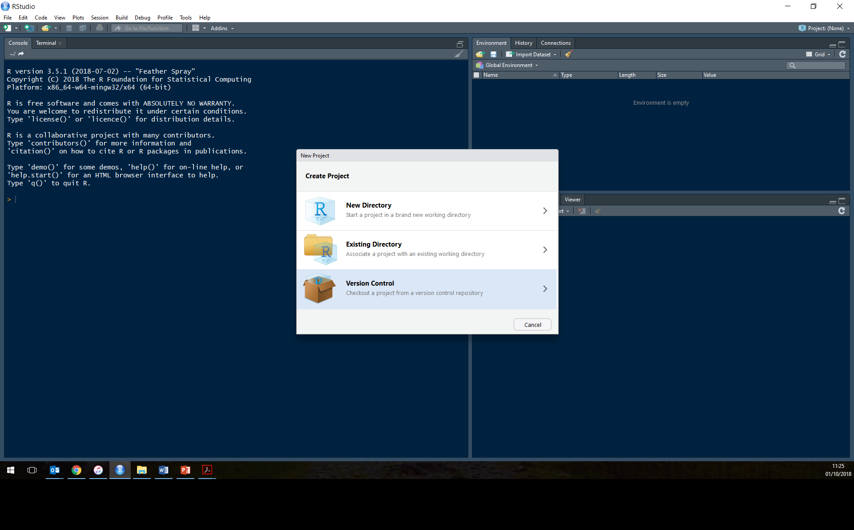

Slide 25
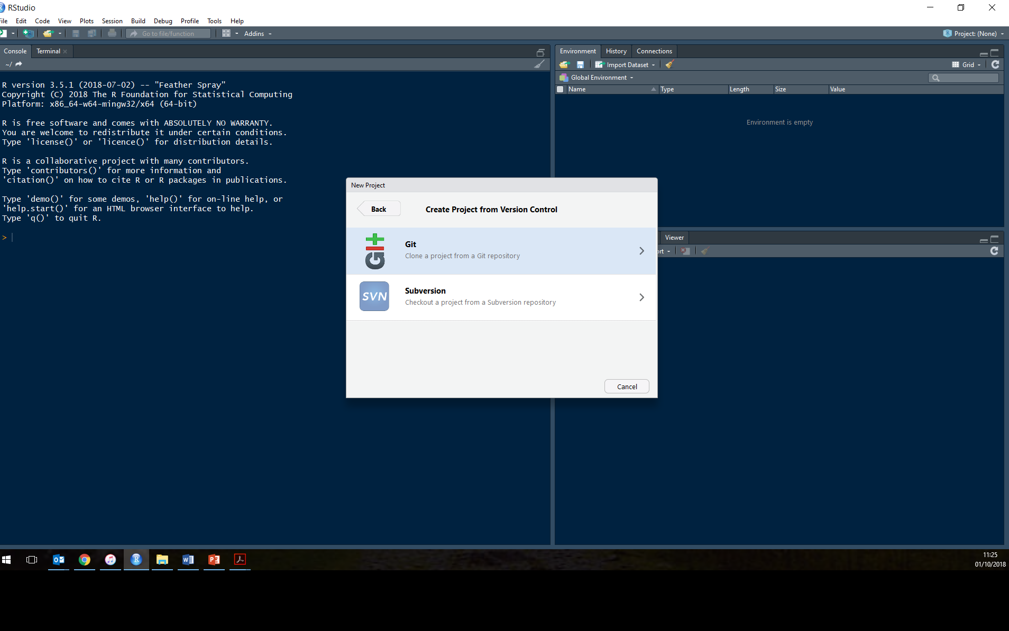

Slide 26
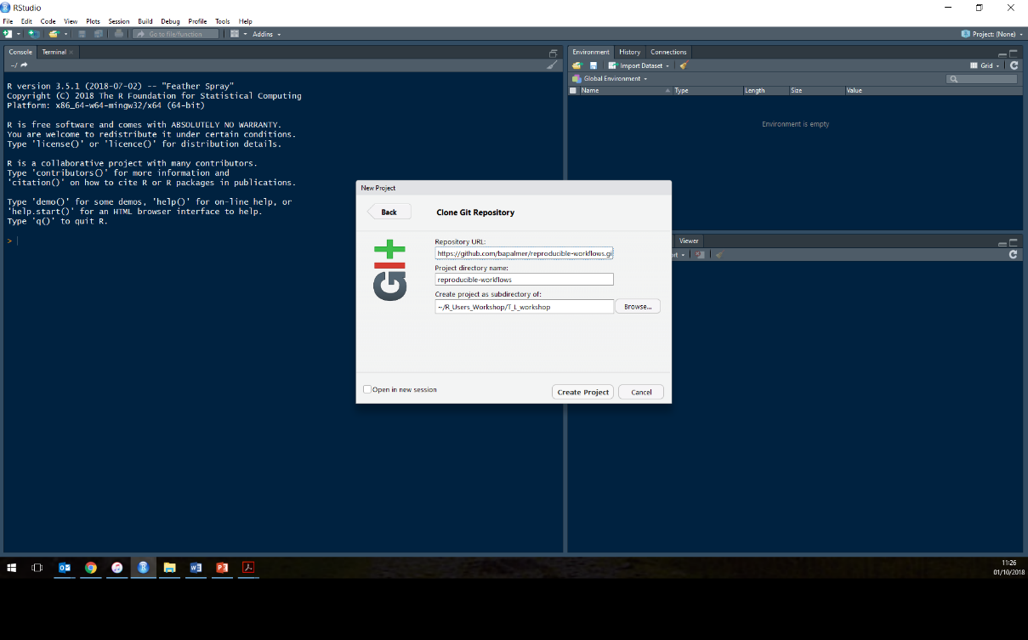

Slide 27
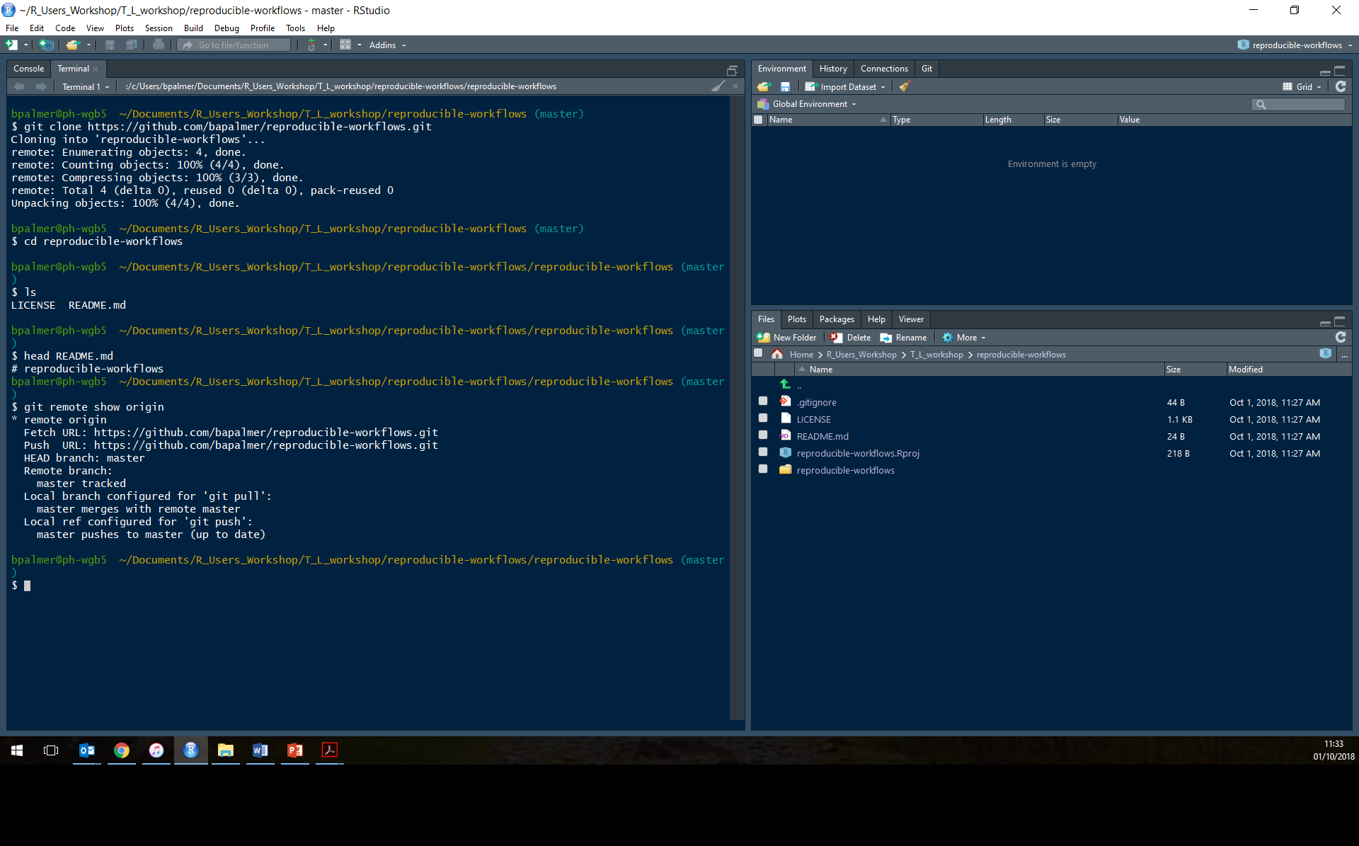
Notes:
Examine the new tabs between the generic R-project and the lunchtime sessions one

Slide 28

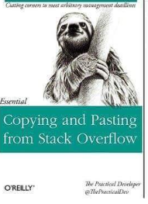




From the people who brought you…..
Notes:
Any idiot could do it. I am that idiot

Slide 29
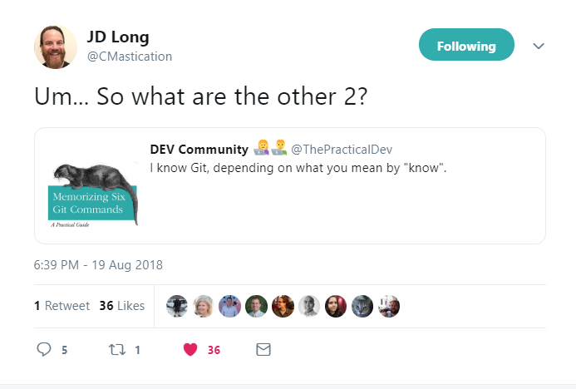

I know git, depending on what you mean by “know”
Notes:
Any idiot could do it. I am that idiot
You have to install Git, get local Git talking to GitHub, and make sure RStudio can talk to local Git (and, therefore, GitHub). This is one-time or once-per-computer pain.

Slide 30
JD speaks the truth
4 main commands just to get started with……
Add: This is where you identify the files you wan to upload
Commit: This is like “saving” your work by creating a new version or copy
Push: This is how you send files from your local project to the online repository
- Pull: This is how you get files from your online repository to your local project
Notes:
Once you finish return to Rstudio and make a change to the read me file

Slide 31
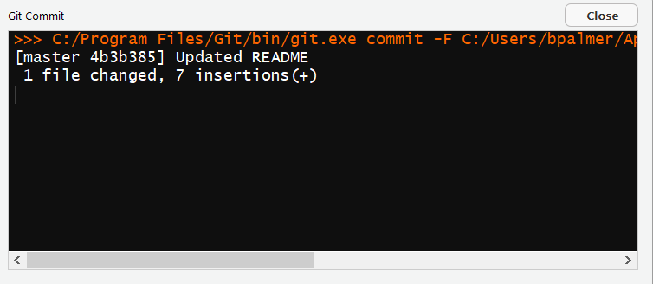
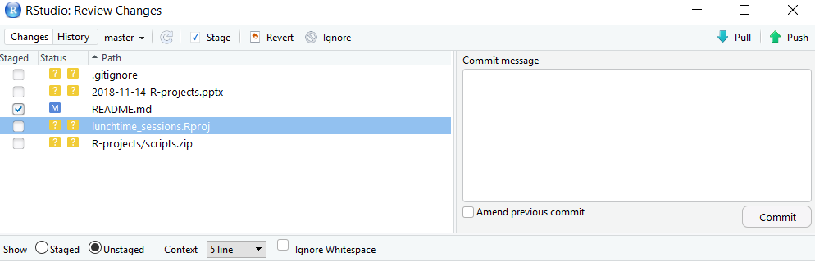
But I don’t know anything about command line
The good news here is that you don’t need to……
Notes:
Once you finish return to Rstudio and make a change to the read me file

Slide 32

https://xkcd.com/1597/

Slide 33
Obviously there are others
Initialise
Checkout
Clone
Fork
Branch
Master
Index Head Merge Stage
Issue Fetch
Clean Check
Status Commit message
Working directory
Notes:
Once you finish return to Rstudio and make a change to the read me file

Slide 34
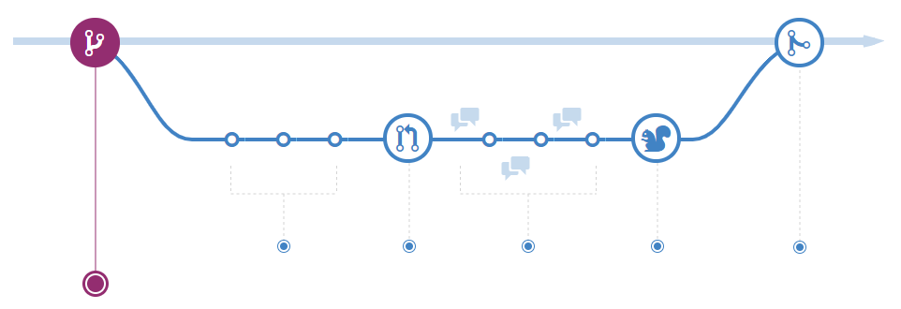
Understanding the GitHub flow:
Notes:
When you're working on a project, you're going to have a bunch of different features or ideas in progress at any given time – some of which are ready to go, and others which are not. Branching exists to help you manage this workflow.

Slide 35
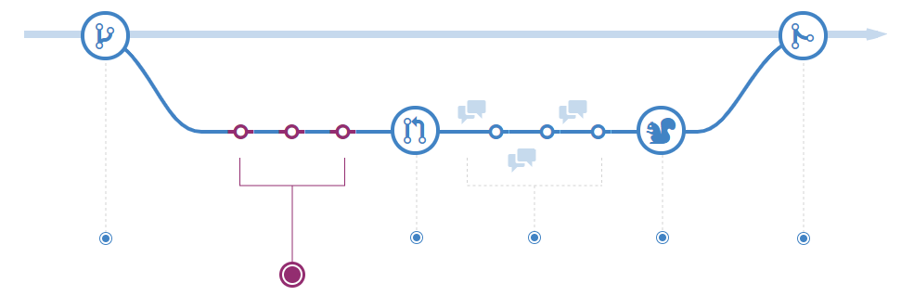
Understanding the GitHub flow: Commit
Notes:
Once your branch has been created, it's time to start making changes. Whenever you add, edit, or delete a file, you're making a commit, and adding them to your branch. This process of adding commits keeps track of your progress as you work on a feature branch.

Slide 36
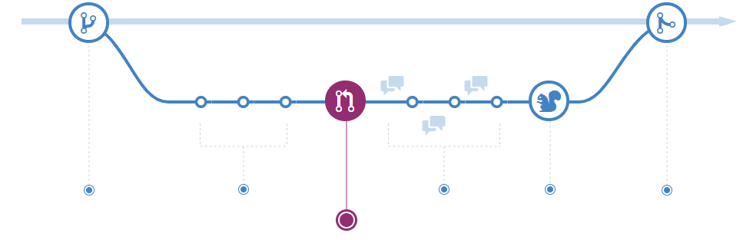
Understanding the GitHub flow: Pull request
Notes:
Pull Requests initiate discussion about your commits. Because they're tightly integrated with the underlying Git repository, anyone can see exactly what changes would be merged if they accept your request.

Slide 37
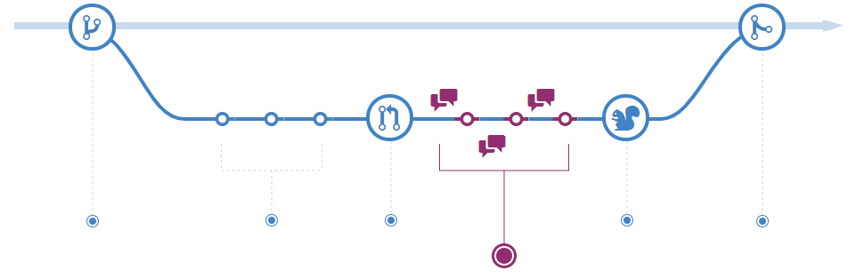
Understanding the GitHub flow: Review
Notes:
Once a Pull Request has been opened, the person or team reviewing your changes may have questions or comments

Slide 38
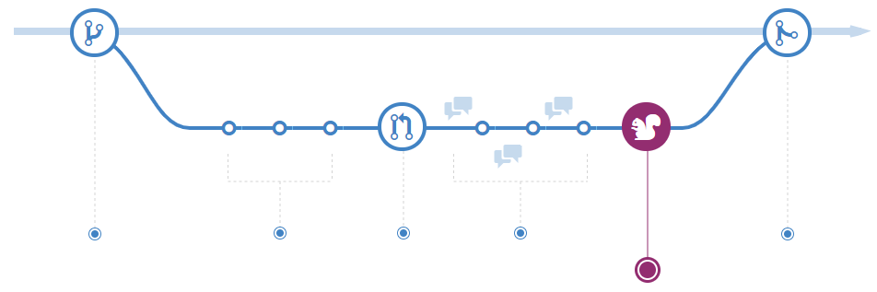
Understanding the GitHub flow: Deploy
Notes:
With GitHub, you can deploy from a branch for final testing in production before merging to master.
Once your pull request has been reviewed and the branch passes your tests, you can deploy your changes to verify them in production. If your branch causes issues, you can roll it back by deploying the existing master into production

Slide 39
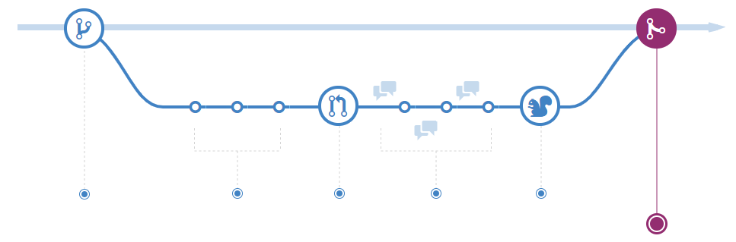
Understanding the GitHub flow: Merge
Notes:
Now that your changes have been verified in production, it is time to merge your code into the master branch.
Once merged, Pull Requests preserve a record of the historical changes to your code. Because they're searchable, they let anyone go back in time to understand why and how a decision was made

Slide 40
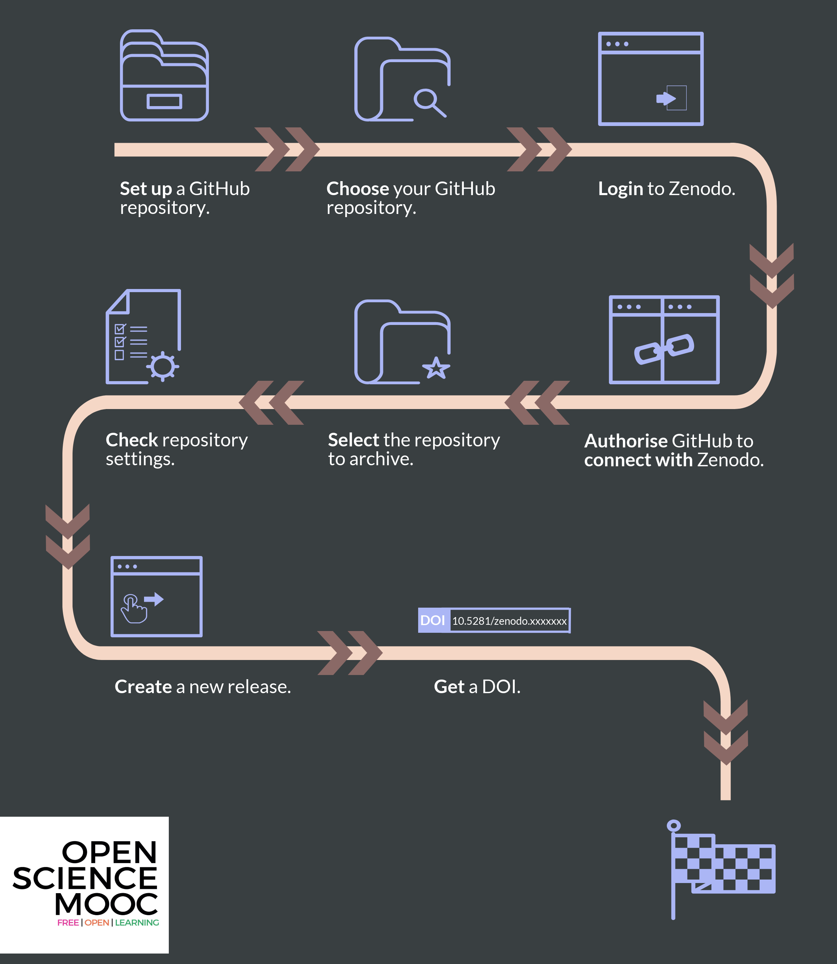
Finishing up
Notes:
On the Zenodo website authorise it to connect to your GitHub account in the 'Using GitHub' section.
Once Zenodo is authorised to configure the repository webbooks that it needs to archive the repository and issue it a DOI.
To make a long story short, the end game is for your GitHub repository to be archived in Zenodo, and with a DOI that can be versioned to reflect updates to the repository version through time. You should be able to see details of this on the GitHub Zenodo page for your repository. This also means that your archived projects can get picked up by other indexing services and search engines that use DOIs too.

Slide 41

Try it for yourself: Tasks 1-3

